Slide 1

Presentation on 4th Year 2nd Semester’s Research Works Course Code: ICT-4000 Course Title: Thesis/Project
Identification of Molecular Signatures and Pathways Shared by Nasopharyngeal Carcinoma (NPC) and Lung Cancer Using Network-Based Approach
Presented by
Supervised by
Alama Jannat Akhi
(IT-16031)
Md. Ahsan Habib
Associate Professor,
Dept. of ICT, MBSTU
Date:14 November, 2021 Sunday
Department of Information and Communication Technology (ICT)
Mawlana Bhashani Science and Technology University
Santosh, Tangail-1902, Bangladesh

Slide 2
Overview
➤ Introduction
➤ Problem Statement
➤ Motivation
➤ Research Objectives
➤ Resources
➤ Methodology
➤ Result Analysis
➤ Conclusion and Future works
➤ Reference

Slide 3
Nasopharyngeal Carcinoma (NPC) & Lung Cancer
Introduction
Nasopharyngeal carcinoma (NPC), or nasopharynx cancer, is the most common cancer originating in the nasopharynx (The area that starts upper part of the throat, behind the nose). It is a leading form of cancer in a few well-defined populations, including natives of southern China, Southeast Asia, the Arctic, and the Middle East/North Africa. So it is driven by both genetic and environmental factors.
Lung cancer is the leading cause of cancer deaths worldwide. .The lungs are among the most prominent target organs for metastatic disease. Cancer that starts in one part of the body and spreads to the lungs is called lung metastases.
NPC in advanced stages exhibits higher metastatic potential than other head and neck squamous cell carcinomas . Most frequently, lung metastases originate from cancers of the head and neck.

Slide 4
Molecular Signatures and Pathways
Introduction(cont.)
➢ Molecular signatures are markers for a particular cell or tissue phenotype.
➢ Signatures have a two-fold purpose: they may be useful for disease diagnosis or risk assessment (prediction), but they may also implicate molecules not previously known to be involved in the underlying molecular pathology (discovery).
➢ Molecular pathways controls a cell’s activities. Each pathway includes many players that interact. Defects in a pathway can cause disease.
➢ Excessive cell growth in cancer is often the consequence of mutant proteins and loss of pathway control.

Slide 5
Problem Statement
➤ NPC has a poor prognosis because of late presentation of lesions, poor understanding of the molecular mechanisms, no suitable markers for early detection, and poor response to available therapies.
➤ NPC has a very complex etiology that is not fully understood yet.
➤ Lung cancer typically doesn't cause signs and symptoms in its earliest stages. Signs and symptoms of lung cancer typically occur when the disease is advanced. Since more advanced stages of lung cancer are incurable, early detection is essential, although no screening test currently exists.

Slide 6
Research Motivation
➤ The 5-year survival rate of stages I and II NPC ranges from 72 to 90 percent. However, the 5-year survival rate of stages III and IV NPC are 55 percent and 30 percent, mostly due to a relatively high incidence metastasis.
➤ The treatment success mostly depends on the tumor, node, and metastasis (TNM) stages classification , which tend to be in the advanced stages at the point of diagnosis because the primary anatomical site of cancer growth is located in the silent painless area.
➤ Lung cancer is the second most common cancer and the leading cause of cancer death for men and women. Lung cancer makes up around 25% of cancer deaths. The survival rate for lung cancer has increased steadily over the past 40 years. It's not just newer and better drugs that have helped improve the odds, but, rather, newer and better categories of drugs that can help to fight the disease.

Slide 7
Research Objectives
➤ To analyze the significant genes that offer a ability to verify risk factor for NPC and LC.
➤ To Identify common genes between NPC and Lung cancer.
➤ To Identify Biomarkers (e.g. Hub genes, miRNAs, TFs) and molecular Pathways abnormally active both in NPC and LC tissues to help predict the short-term efficacy which may shed some light on the key pathogenic processes involved.
➤ Finally to suggest some drugs based on the highly connected proteins to discover a combined therapuetic approach for NPC and LC.

Slide 8
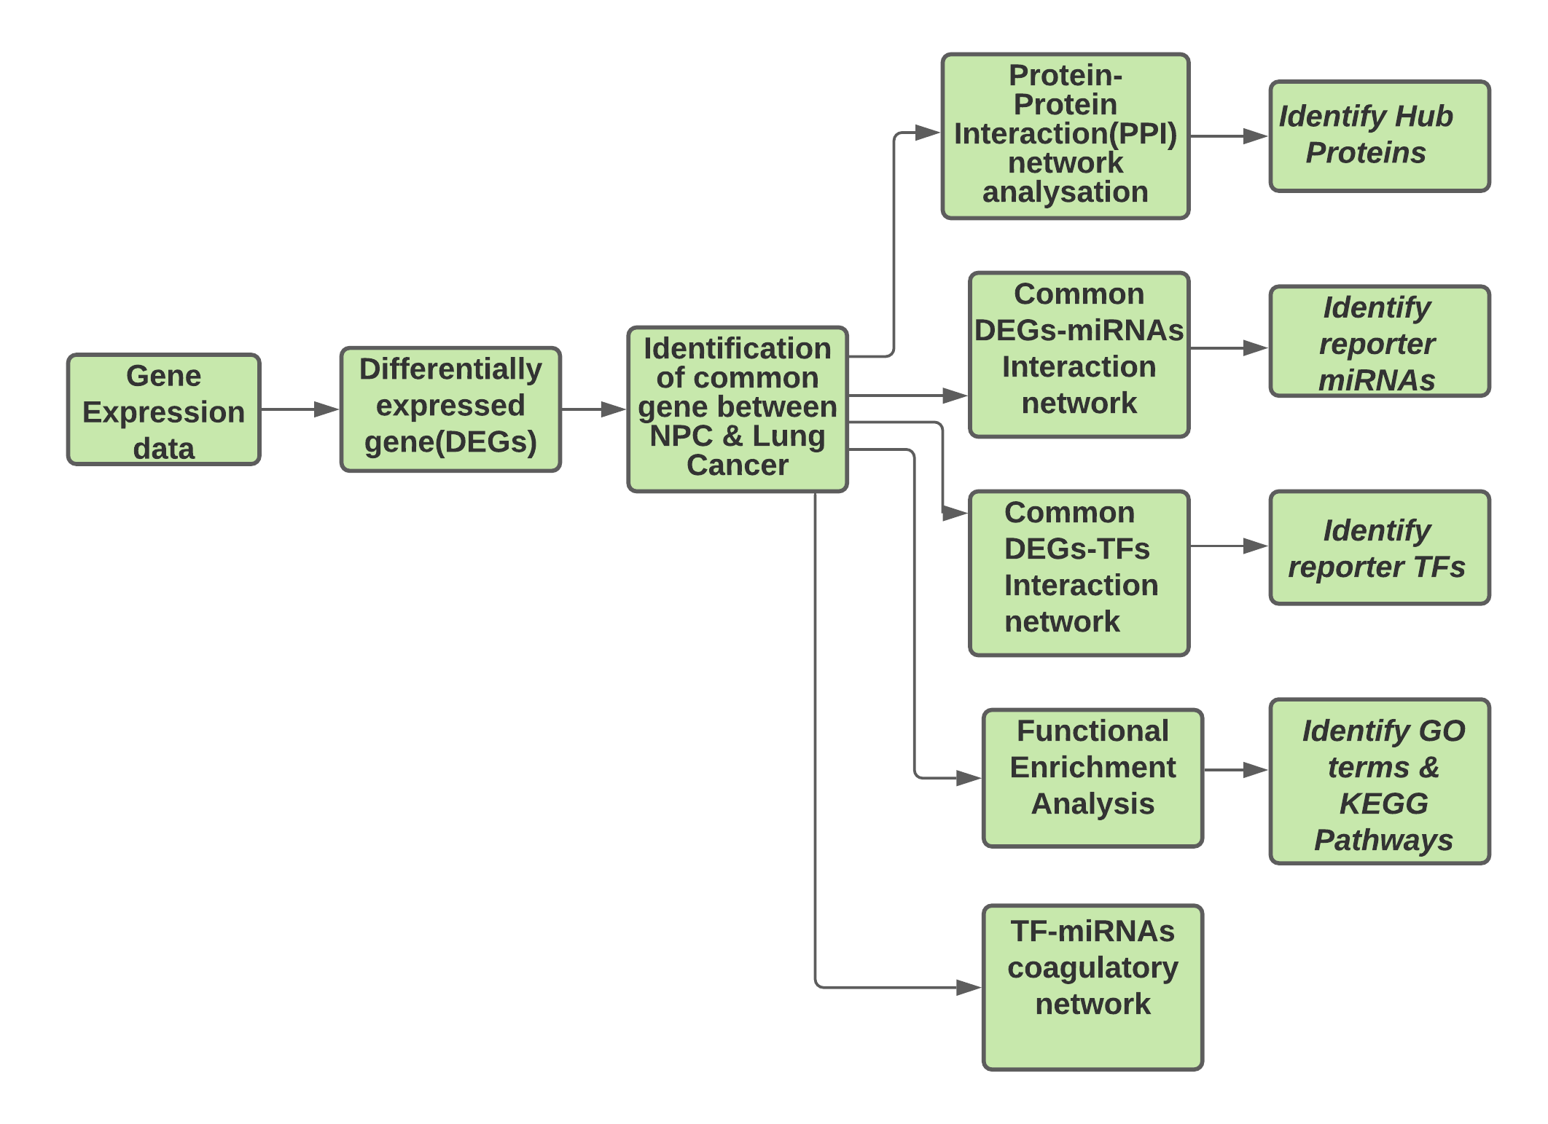
Work-Flow Diagram

Slide 9





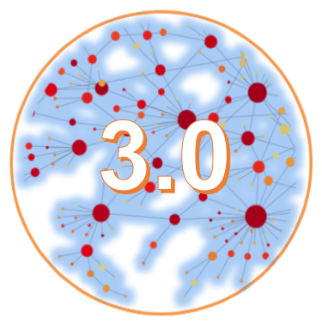
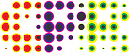
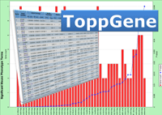

Resources

Slide 10
Methodology
➢ From the NCBI (GEO), the gene expression data of nasopharyngeal carcinoma (GSE53819) and lung cancer (GSE75037 ) for this study was obtained.
➢ To identify DEGs, Students unaired t-test was done and p-value <0.01 considered.
The common genes between these two cancer were identified using python.
➢ Network was visualized and analyzed by Network Analyst and cytoscape.
➢ By applying topological analysis hub proteins were identified considering highest degree and betweenness centrality.
➢ reporter biomolecules (TFs and miRNAs) were obtained from JASPAR database & miRTarBase respectively.
➢ Pathway analysis was executed to get more insight into the molecular pathways of NPC using ToppGene and DAVID resources. GO terms was executed using FunRichr.

Slide 11
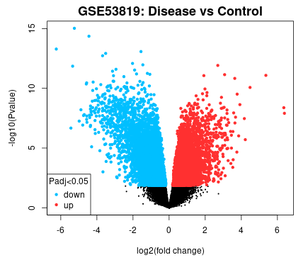
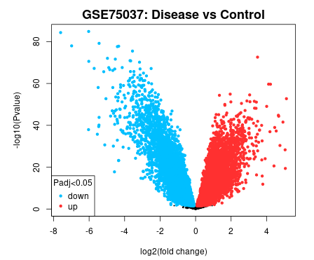
Fig: (a)Volcano plot shows 598 DEGs for NPC (up-regulated 166 genes and down-regulated 432 genes) , (b) 831 DEGs for LC (up-regulated 280 genes and down-regulated 551 genes)
Results

Slide 12
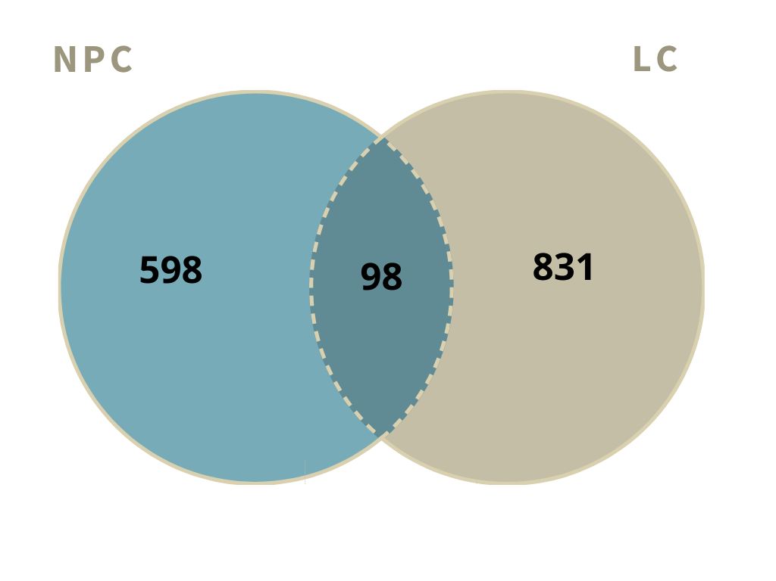
Fig: Venn diagram shows 98 common genes between NPC and LC where 25 genes are up regulated and 73 Genes are down regulated.
Results(cont.)

Slide 13
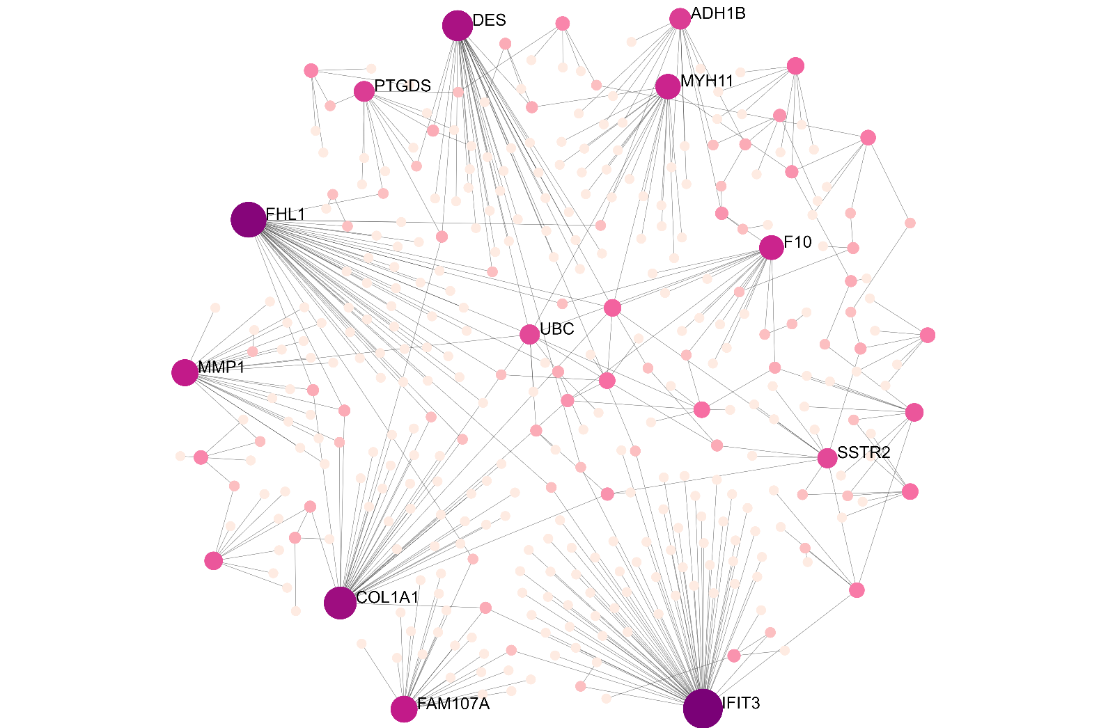
Fig: The Protein-Protein Interaction Network (PPI) with 365 nodes and 410 edges using the 98 common genes associated with NPC and LC.
PPI Network

Slide 14
PPI Network Analysis
Table: Top 10 selected Hub Proteins
Table: The pathways involved with the common genes between NPC and Lung cancer.
 | Symbol | Degree | Betweenness
 | IFIT3 | 60 | 21404.68
 | FHL1 | 45 | 20223.11
 | COL1A1 | 36 | 18277.8
 | DES | 31 | 14021.38
 | CA9 | 30 | 464
 | MMP1 | 22 | 8086.84
 | FAM107A | 22 | 6869.92
 | MYH11 | 22 | 609
 | CH25H | 20 | 190
 | F10 | 18 | 9110.61
KEGG Pathways |  | Total | Expected | Hits | P.Value
ECM-receptor interac- |  | 82 | 0.265 | 8 | 1.05E-10
tion
Amoebiasis |  | 96 | 0.31 | 6 | 4.56E-07
Focal adhesion |  | 199 | 0.643 | 7 | 2.17E-06
PI3K-Akt signaling path- |  | 354 | 1.14 | 8 | 9.68E-06
way
AGE-RAGE | signaling | 100 | 0.323 | 5 | 1.41E-05
pathway in | diabetic
complications
Proteoglycans in cancer |  | 201 | 0.649 | 6 | 3.34E-05
Platelet activation |  | 124 | 0.401 | 5 | 4.01E-05
Renin-angiotensin sys- |  | 23 | 0.0743 | 3 | 5.06E-05
tem
Hypertrophic cardiomy- |  | 85 | 0.275 | 4 | 0.000144
opathy (HCM)
Protein digestion and ab- |  | 90 | 0.291 | 4 | 0.00018
sorption

Slide 15
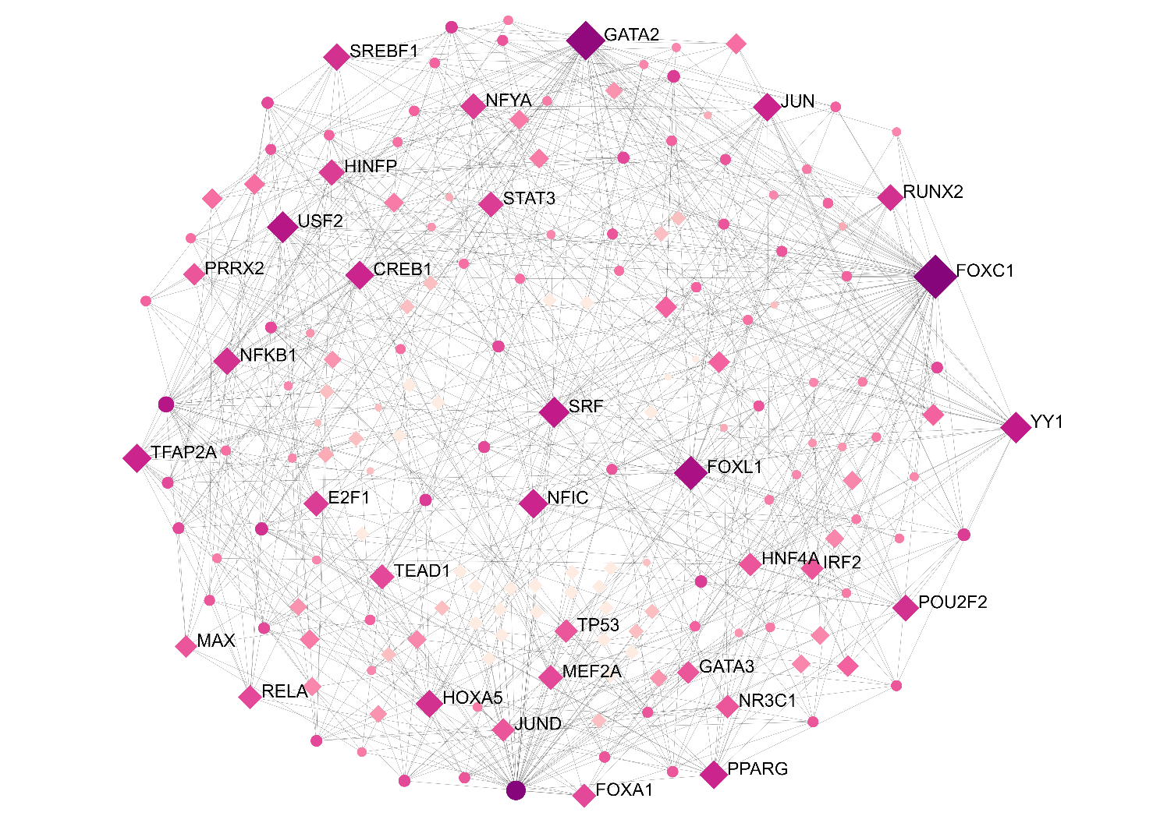
Fig: The interaction network between transcription factor and common 98 genes with 184 nodes and 745 edges.
TF-Common Genes Interaction Network

Slide 16
TF-Common Genes Interaction Network Analysis
Table: Top 10 selected reporter TFs
Table: 10 Top-ranked KEGG pathways involved in TFs-genes interaction networks.
 | Symbol | Degree | Betweenness
 | FOXC1 | 66 | 3906.7
 | GATA2 | 47 | 1900.7
 | FOXL1 | 30 | 778.28
 | USF2 | 25 | 459.16
 | YY1 | 24 | 658
 | SRF | 23 | 456.5
 | NFIC | 20 | 445.28
 | TFAP2A | 19 | 981.36
 | CREB1 | 19 | 258.21
 | PPARG | 18 | 376.36
Pathway |  | Total | Expected | Hits | P.Value
Prolactin | signal- | 70 | 0.841 | 10 | 8.44E-09
ing pathway
Transcriptional |  | 186 | 2.24 | 13 | 2.85E-07
misregulation in
cancer
HTLV-I infection |  | 219 | 2.63 | 13 | 1.84E-06
Osteoclast | differ- | 128 | 1.54 | 10 | 2.73E-06
entiation
Hepatitis B |  | 163 | 1.96 | 11 | 3.55E-06
Leishmaniasis |  | 74 | 0.889 | 7 | 2.70E-05
Th17 cell differen- |  | 107 | 1.29 | 8 | 3.96E-05
tiation
Pathways in can- |  | 530 | 6.37 | 18 | 4.80E-05
cer
Kaposi’s sarcoma- |  | 186 | 2.24 | 10 | 7.25E-05
associated | her-
pesvirus infection
Th1 and Th2 cell |  | 92 | 1.11 | 7 | 0.00011
differentiation

Slide 17
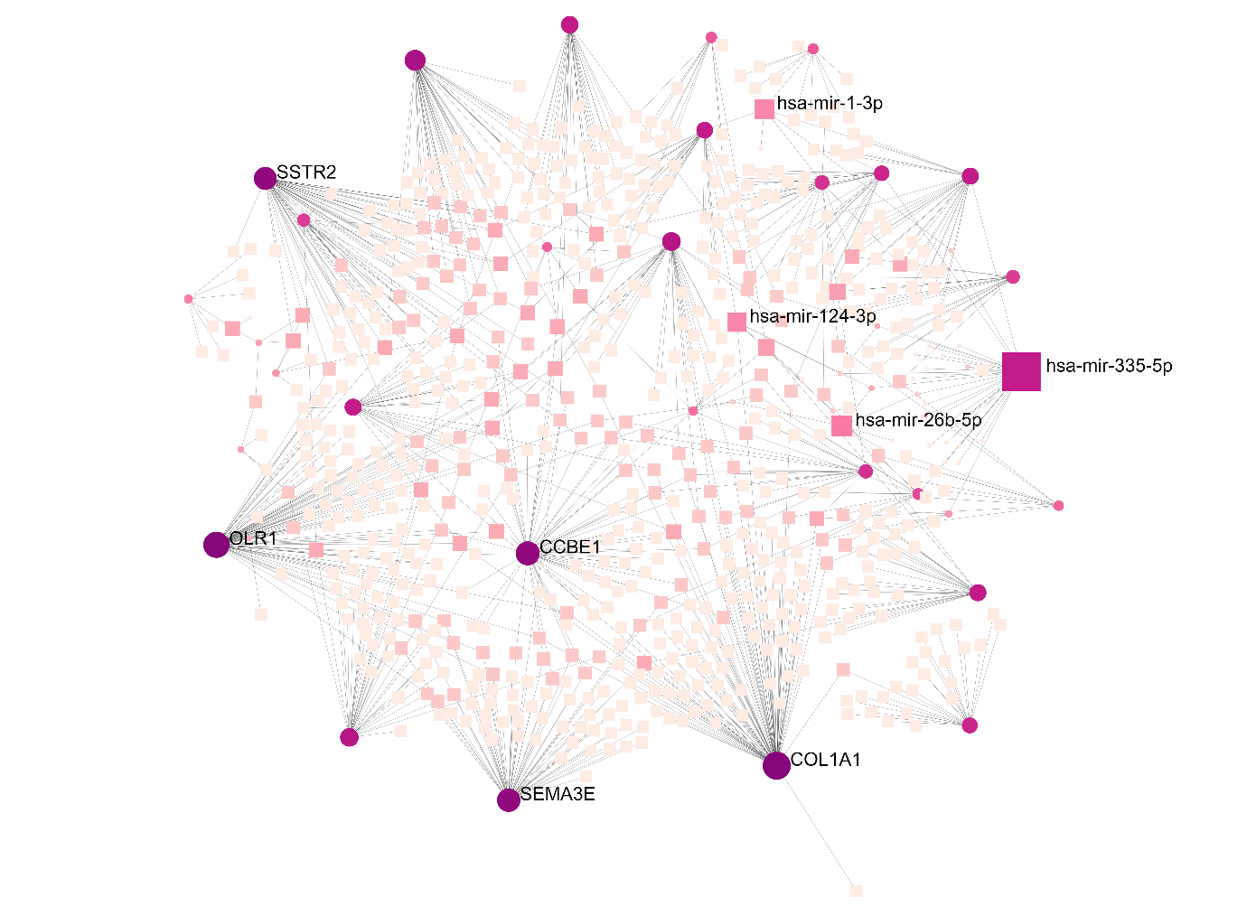
Fig: The interaction network between micro RNA and common 98 genes with 740 nodes and 872 edges.
miRNA-Common Genes Interaction Network

Slide 18
miRNA-Common Genes Interaction Network Analysis
Table: 10 Top-ranked KEGG pathways involved in the micro RNAs-genes interaction network.
Table: Top 10 selected reporter miRNAs
 | Symbol | Degree | Betweenness
 | hsa-mir-335-5p | 30 | 31203.41
 | hsa-miR-768-5p | 7 | 8009.46
 | hsa-mir-26b-5p | 7 | 2795.99
 | hsa-miR-30b | 7 | 2232.98
 | hsa-mir-1-3p | 6 | 16611.77
 | hsa-mir-124-3p | 6 | 14194.76
 | hsa-miR-101 | 6 | 2705.78
 | hsa-miR-144 | 6 | 2474.61
 | hsa-miR-30a | 6 | 1585.67
 | hsa-miR-16 | 6 | 1546.21
Pathway | Total | Expected | Hits | P.Value
Complement and co- | 79 | 0.317 | 3 | 0.00375
agulation cascades
Protein digestion and | 90 | 0.361 | 3 | 0.00541
absorption
Prion diseases | 35 | 0.14 | 2 | 0.00851
Tyrosine metabolism | 36 | 0.144 | 2 | 0.00899
Systemic lupus ery- | 133 | 0.533 | 3 | 0.0157
thematosus
Phagosome | 152 | 0.609 | 3 | 0.0224
Cytokine-cytokine re- | 294 | 1.18 | 4 | 0.0286
ceptor interaction
Drug metabolism - | 72 | 0.288 | 2 | 0.0334
cytochrome P450
Metabolism of xeno- | 76 | 0.305 | 2 | 0.0369
biotics by cytochrome
P450
Taurine and hypotau- | 11 | 0.0441 | 1 | 0.0432
rine metabolism

Slide 19
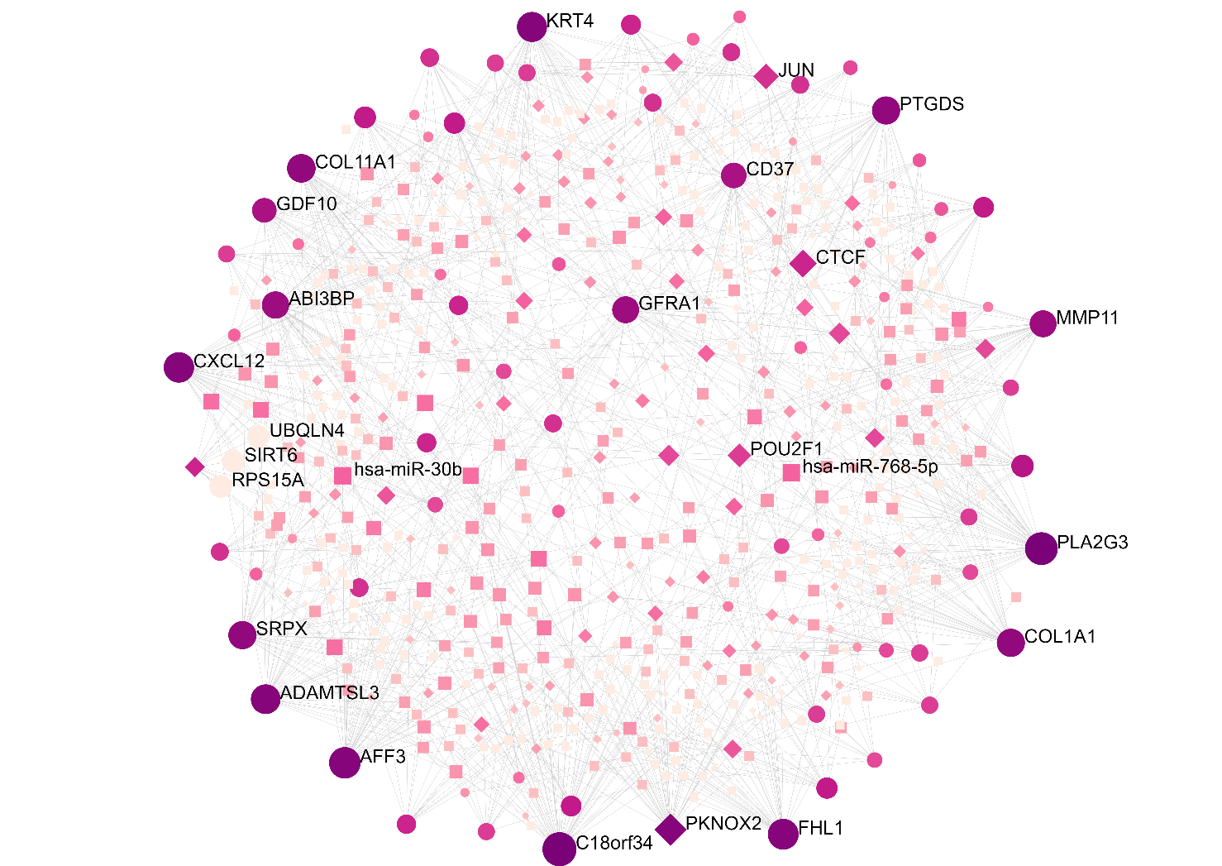
Fig: The TF-miRNAs coagulatory network with 622 nodes and 1211 edges using 98 common genes
TF-miRNAs coagulatory network

Slide 20
TF-miRNAs coagulatory network Analysis
Table : 10 Top-ranked KEGG pathways involved ithe TF-miRNAs coagulatory network.
Pathway |  | Total | Expected | Hits | P.Value
Transcriptional mis- |  | 186 | 3.29 | 26 | 9.92E-17
regulation in cancer
Hepatitis B |  | 163 | 2.89 | 22 | 6.11E-14
Pathways in cancer |  | 530 | 9.38 | 36 | 8.14E-13
HTLV-I infection |  | 219 | 3.88 | 23 | 3.50E-12
Th17 cell differentia- |  | 107 | 1.89 | 16 | 4.26E-11
tion
Osteoclast | differenti- | 128 | 2.27 | 15 | 5.88E-09
ation
Non-small cell lung |  | 66 | 1.17 | 11 | 1.68E-08
cancer
Small cell lung cancer |  | 93 | 1.65 | 12 | 7.18E-08
Prostate cancer |  | 97 | 1.72 | 12 | 1.16E-07
Kaposi’s | sarcoma- | 186 | 3.29 | 16 | 1.52E-07
associated | her-
pesvirus infection

Slide 21
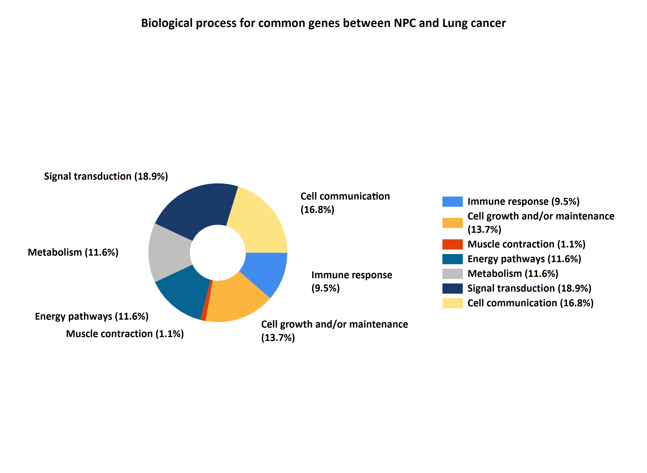
GO Terms: Biological Process

Slide 22
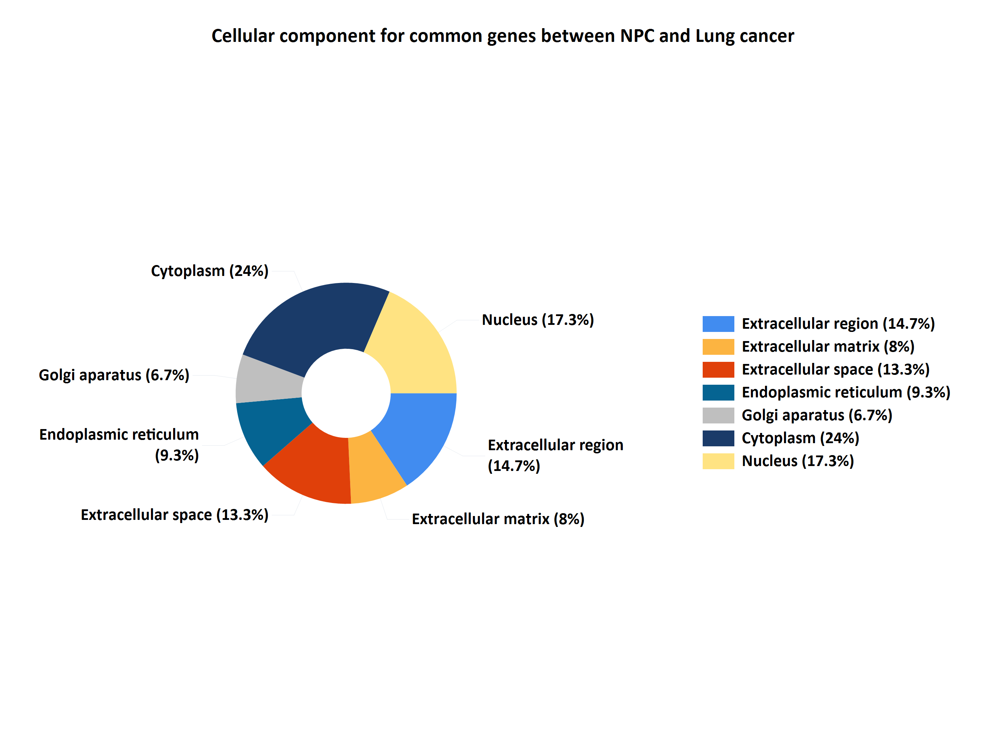
GO Terms: Cellular Component

Slide 23
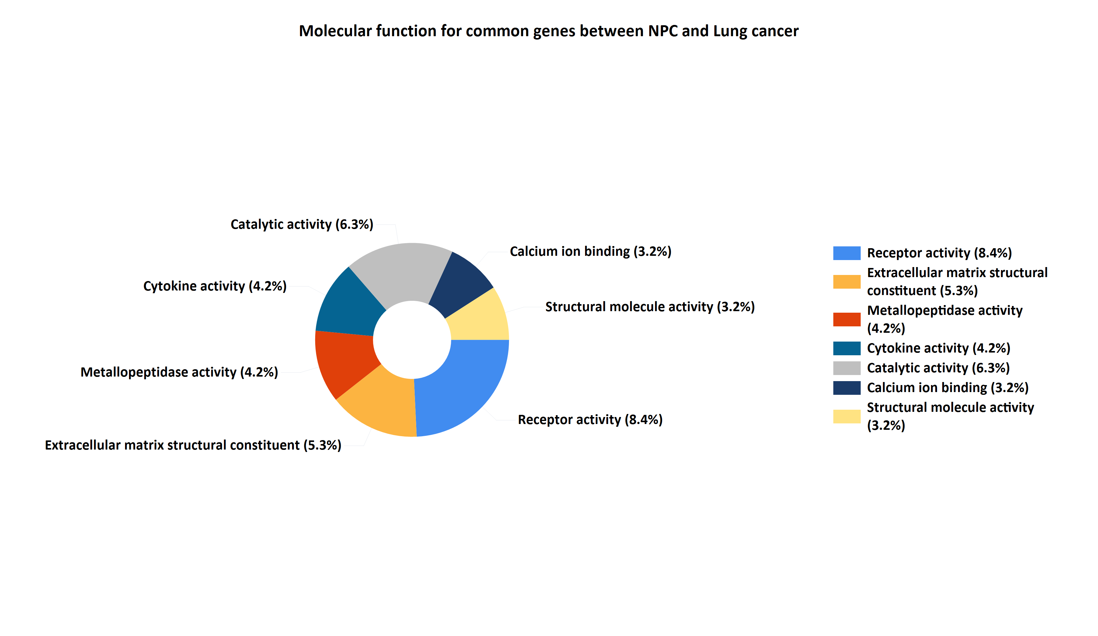
GO Terms: Molecular Function

Slide 24
Suggested Drugs
Table: Six suggested drugs based on 10 selected Hub Proteins
Drug Name | p-value | q-value | Hits | Hits in the query list
 |  | Bonfer-
 |  | roni
Doxorubicin | 1.60E-06 | 8.68E-03 | 7 | CA9,FHL1,FAM107A,MMP1,
 |  |  |  | DES,COL1A1,CH25H
ethylnylestradiol | 4.64E-06 | 2.52E-02 | 6 | CA9,MMP1,DES,IFIT3,
 |  |  |  | COL1A1,CH25H
Bleomycin | 5.03E-07 | 2.73E-03 | 5 | FHL1,MYH11,MMP1,DES,
 |  |  |  | COL1A1
Paromomycin sul- | 1.06E-06 | 5.76E-03 | 4 | CA9,FHL1,DES,COL1A1
fate
Methyldopa | 1.11E-06 | 6.00E-03 | 4 | CA9,FHL1,DES,COL1A1
Dasatinib | 3.60E-05 | 1.96E-01 | 4 | FHL1,MYH11,MMP1,IFIT3

Slide 25
Suggested Drugs
● Those six drugs are all approved and in production.
● Doxorubicin, sold under the brand name Adriamycin among others, is a chemo therapy medication used to treat cancer [1].
● Bleomycin is a medication used to treat cancer [2] .
● Paromomycin is an antimicrobial used to treat several parasitic infections including amebiasis, giardiasis, leishmaniasis, and tapeworm infection[3].
● Methyldopa, sold under the brand name Aldomet among others, is a medication used for high blood pressure [4].
● Dasatinib, sold under the brand name Sprycel among others, is a targeted therapy medication used to treat certain cases of chronic/acute leukemia [5].

Slide 26
Conclusion
● The present study provides possible novel links of association between the NPC and LC which could eventually translate into additional biomarkers to facilitate the early diagnosis and therapeutic approaches.
● This approach will be useful to predict association occurrence for other diseases.

Slide 27
Limitations
A few limitations of this study is given below:
● Extensive validation of these molecules in a larger cohort need to be done.
● The identified biomolecules presented in this study deserve experimental studies to clarify the biological roles in association of NPC and LC.
● A multicenter platform is essential to verify their usefulness as biomarkers.

Slide 28
Future Works
Some Future works of this thesis are given below:
● This study further may lead to ultimate advancement for therapeutic strategies.
● A different bioinformatics approach or different dataset like transcriptomic dataset can be taken to discover new biomolecules shared by NPC and LC.

Slide 29
References
[1] N. Greene, Oncology Drugs: Shortages, Pricing and Target Product Profile Analysis in the US Market. Massachusetts College of Pharmacy and Health Sciences, 2016.
[2] G. O Moustafa, “Peptide chemistry’s contribution to the treatment of the majority of serious illnesses: Peptide antitumors.” Egyptian Journal of Chemistry, vol. 64, no. 11, pp. 5–6, 2021.
[3] E. R. Fox and L. S. Tyler, “Managing drug shortages: seven years’ experience at one health system,” American journal of health-system pharmacy, vol. 60, no. 3, pp. 245–253, 2003.
[4] D. W. Newton, A. G. Rogers, C. H. Becker, and G. Torosian, “Extemporaneous preparation of methyldopa in two syrup vehicles,” American Journal of Health-System Pharmacy, vol. 32, no. 8, pp. 817–821, 1975.
[5] C. Fausel, “Targeted chronic myeloid leukemia therapy: seeking a cure,” American journal of health-system pharmacy, vol. 64, no. 24_Supplement_15, pp. S9–S15, 2007.

Slide 30
Thank You
Abby Author, CTO

